Slide 1
EXPORT MARKETING Dr. SUMITA SHANKAR

Slide 3
FOREIGN TRADE POLICY 2015-2020

Slide 4
OBJECTIVES OF FTP 2015-2020 To promote India’s merchandise Export and services export To raise India’s share in world export To increase value addition along with export import of goods and services. To give boost to export of Hi-tech and defence items Foreign Trade policy to be aligned with India’s vision To provide sustainable and stable environment for export. Creations of Jobs To face challenges in international trade

Slide 5
HIGHLIGHTS OF FTP 2015-2020

Slide 6
Introduction of two new schemes:
MEIS (Merchandise Exports from India Scheme.
SEIS (Service Exports from India Scheme)

Slide 7
2. Incentives for services Export:

Slide 8
3. Incentives to Units from Special Economic Zones (SEZs)

Slide 9
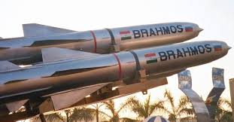
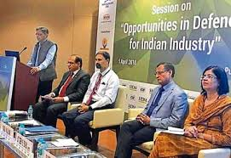
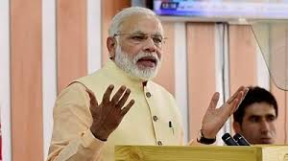
.4. Export of Defence products

Slide 10
. 5. Incentives to exports by E-Commerce

Slide 11
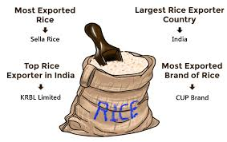
6. Branding of Export products

Slide 12
7. Encouragement to paperless trade

Slide 13
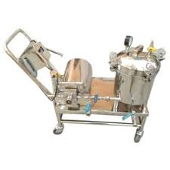
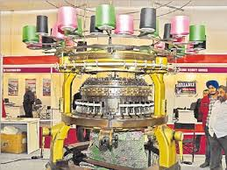
8. Boost to local manufacturing of machinery

Slide 14
9. Departure from the practice of annual supplements to FTP .

Slide 15
1. Status Holders 2. Simplification of procedures 3. New Initiatives to EOU/ stp 4. special benefits to handloom Products 5. Resolve Quality complaints and trade disputes
10 . Miscellaneous highlights of FTP

